Slide 1



Northeastern University
CUMULATIVE PRIVACY PROPOSAL FOR STATE X
BY: DOMINIQUE COPELAND

Slide 2

Overview
1
2
3
4
5
6
  7
Introduction
  Federal Laws
  State Laws
  Model State Data Privacy Act
International Law
Compilation for the Future
  Sources

Slide 3
Introduction
  The critical issues affecting citizens of State X are limited privacy rights for individuals and employees, lack of AI protections to mitigate harms to physical and mental safety, and limited cooperation to ensure citizens of State X remain protected.

Slide 4
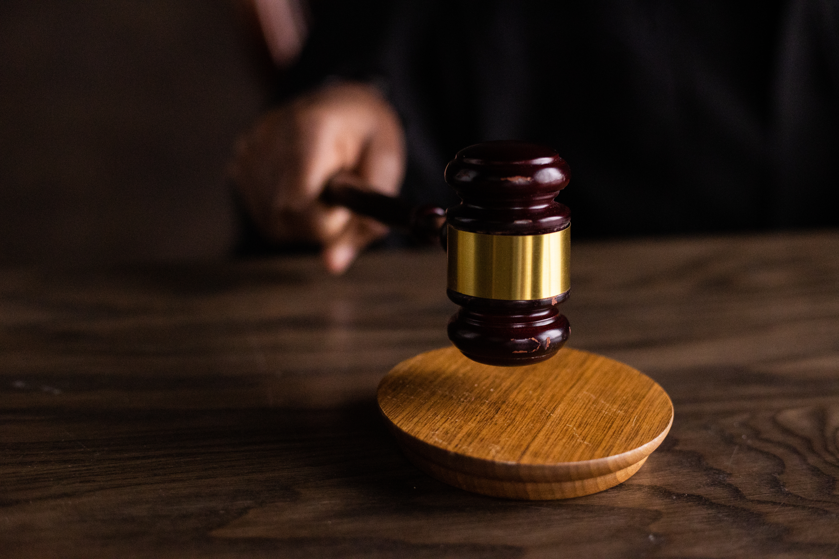
Areas Federal Law Covers
  The Electronic Communications Privacy Act-governs wiretapping and electronic eavesdropping (18 U.S.C. §§ 2510–2522)
  Right to Financial Privacy Act-governs financial records (12 U.S.C. §§ 3401-342)
  The Cable Communications Privacy Act-governs conversations with cable providers (47 U.S. Code § 551)
  The Video Privacy Protection Act-governs video tape service providers (18 U.S. Code § 2710)
  The Employee Polygraph Protection Act-governs employee polygraphs (29 U.S.C. §§ 2001–2009)
  The Telephone Consumer Protection Act-governs telephone equipment and solicitation (47 U.S. Code § 227)
  The Driver’s Privacy Protection Act-prohibits release and use of certain personal information from state motor vehicle records (18 U.S.C. § 2721)
  The Gramm-Leach-Bliley Act-governs consumers within financial institutions (15 U.S.C. §§ 6801–6809)
  The Health Insurance Portability and Accountability Act-governs healthcare data (42 U.S.C. § 1320d-2)
  The Federal Trade Commission-governs unfair or deceptive data practices (16 C.F.R. (2025))
  The Children's Online Privacy Protection Act-governs data of minor sunder 13 (15 U.S.C. §§ 6501–6506)

Slide 5
Privacy Act
  Governs records collected by federal agencies
  Encourages collection of data for relevant and necessary purposes
  Encourages collection from the individual directly
  Promotes transparency of how records will be kept and monitored
  Provides individuals with access to their records
  Requires consent for disclosure unless it is for law enforcement, court requests, or national security
  Encourages tracking of disclosures
  Provides administrative guidelines for notice, access, and amendment processes
  Provides civil remedies and criminal penalties
  Governs contractors of agencies in addition to the agencies themselves

Slide 6


Federal Law Concerns
Private right of action is limited under federal law.
The focus is on collection without assessing prevention or use.
The government is given deference over the individual.

Slide 7
Areas State Law Covers
  Data Breach Notification
  Biometric Data
  Genetic Data
  Health Data
  Artificial Intelligence
  Social Media Password Protection
  Social Security Number Protection
  States can provide greater protection than federal privacy provisions

Slide 8
Massachusetts & New Jersey Protections
  The upcoming Massachusetts Consumer Data Privacy Act includes a ban on the sale of precise geolocation data. This helps protect people from surveillance, stalking, and the misuse of sensitive personal information. This protection is extended to both residents of Massachusetts and visitors. This is especially important when protecting people who travel to and within Massachusetts, including for reproductive and gender affirming health care.
  In New Jersey, there is a total ban on selling sensitive data. It applies to all individuals or legal entities regardless of the number of consumers whose data the individual or entity controls or processes.
  In Maryland, Oregon, Virginia, and Connecticut, there is a partial ban on some categories of sensitive data.
(S. 2608, 194th Gen. Ct. (Mass. 2025), N.J. P.L.2026, c.25)

Slide 9
California Privacy Rights Act (CPRA)
  The privacy rights of employees and independent contractors are considered and protected. (Sec. 3 (A)(8))
  The CPRA does not interfere with the rights to organize or to participate in collective bargaining that are granted under the National Labor Relations Act. (Sec. 3 (A)(8))
  There are exemptions for employees and businesses regarding “business communications”. (Sec. 3 (A)(8))
  Personal information that is collected by a business in the course of acting as a job applicant, employee, or contractor solely within the context of their role or former role the CPRA does not apply. (1798.145(m)(1)(A))
  Personal information that is collected by a business for emergency contact information or employee benefits does not fall under the CPRA. (1798.145(m)(1)(B-C))
  Prohibits retaliation towards employees, applicants, and contractors following them exercising their right to opt out (1798.25(1)(E))

Slide 10
California Consumer Privacy Act (CCPA)
  Job applicants and employees have rights.
  Notice at collection of data
  Right to know and to access categories and specifics of data collected
  Right to delete data collected
  Right to limit sensitive data use
  Right to not be discriminated against for using CCPA privacy rights
(Cal. Civ. Code § 1798.100–1798.199)

Slide 11
Virginia & Connecticut Privacy Protections
  Discourages employers from releasing, communicating, or distributing to a third party any current or former employee's personal identifying information including home telephone number, mobile telephone number, email address, shift times, or work schedule (VA §40.1-28.7:4)
  Discourages employers from using an employee's social security number or any derivative thereof as such employee's identification number (VA §40.1-28.7:10)
  "Consumer" does not include an individual acting in an employment context, or as an employee or contractor. (CT Gen Stat § 42-515(8))
  Data processed or maintained in the course of an individual applying to, being employed by, or being and independent contractor of a business that is used to the extent that the data is collected and used within the context of their role is exempt from the Connecticut Data Privacy Act. (CT Gen Stat § 42-517(b)(15)(A))

Slide 12
New York & Connecticut & Delaware Privacy Protections
  Employers engaged in electronic monitoring shall give prior written notice upon hiring to all employees who are subject to electronic monitoring. (NY Civ Rights L § 52-C-2)
  Employers engaged in any type of electronic monitoring shall give prior written notice to all employees who may be affected, informing them of the types of monitoring which may occur. (CT Gen Stat § 31-48d)
  Employers engaged in monitoring of or by a Delaware employee must provide notice. (19 DE Code § 705(b)(1-2))

Slide 13
  AI & Chatbots (S.B. 896, 126th Gen. Assemb., Reg. Sess. (S.C. 2026) & (S.B. 1037, 126th Gen. Assemb., Reg. Sess. (S.C. 2026))
  Places limits on the time people spend interacting with chatbots
  Chatbots manipulate people by design.
  Chatbots influence unhealthy attachments.
  Chatbots target advertisements to people based on sensitive personal information.
  Chatbots exploit users’ personal data by using it for out-of-context purposes.
  Chatbots provide unlicensed medical, legal, and financial advice.
  Chatbots tell users that they are human.
  Chatbots use people’s personal data to train AI without their knowledge or consent.
  Covered entities must create a limited-access mode so that any unverified user may only access and interact with a chatbot in the limited-access mode.
  Minors should only be able to use limited-access mode unless parental consent is obtained.
  Covered entities cannot prioritize engagement, revenue, or retention metrics, such as session length, frequency of use, or emotional engagement, at the expense of users’ well-being.
  Covered entities should implement reasonable systems and processes to identify when a user is developing emotional dependence.
  Covered entities should not provide unlicensed advice or make materially false representations of being human.
  If a covered entity obtains knowledge that a user faces an imminent risk of death or serious physical injury, then the covered entity must make reasonable efforts, within twenty-four hours, to notify appropriate emergency services or law enforcement, to the extent practical.

Slide 14
  AI & Chatbots (S.B. 827, 448th Gen. Assemb., Reg. Sess. (Md. 2026))
  Creates guardrails for interactions with chatbots
  Chatbots are trained using data that was scraped indiscriminately without knowledge or consent, including copyrighted and other protected work, as well as sensitive personal information.
  Some AI companies, including OpenAI and Meta, have already begun or announced plans to integrate their chatbots into their targeted advertising business streams.
  Chatbots use personal information about users including mental health issues, substance abuse, relationship or family problems, etc. to incentivize unhealthy attachments. This can be used for profit.
  For example, a teenager who tells a chatbot that she is struggling with her body image and is engaging in disordered eating to lose weight may be fed a targeted advertisement for a GLP-1 or a fad diet.
  Requires affirmative consent from users
  Chatbot operators cannot process a user’s chat log for certain advertising purposes.
  Chatbot operators cannot profile a user other than for what is necessary to respond to a user prompt.
  Chatbot operators cannot retain a chat log for longer than 10 years, unless required by law.
  Chatbot operators cannot provide advice or a service that an individual cannot lawfully provide without a license, in violation of applicable State licensing laws.
  Chatbot operators must provide clear and conspicuous warnings that chatbots are artificially generated and not human. The warnings must be both static and dynamic.
  Requires the Behavioral Health Administration (BHA) within MDH to develop educational materials that contain information describing how a person may obtain behavioral health care from a licensed medical professional in the State and about free or low-cost services available to individuals in the State who are experiencing a mental health crisis. This will allow users to better separate unlicensed advice from licensed advice.
  The materials must be disseminated to the public by OAG and used for any other purpose as determined by MDH.

Slide 15
  AI & Automated Decision-Making (OAL Matter No. 2025-0515-01 (June 27, 2025))
In California under the Fair Employment and Housing Act:
  The use of an automated-decision system can violate California law if it harms applicants or employees based on protected characteristics, such as gender, race, or disability.
  Employers and covered entities must maintain employment records, including automated-decision data, for a minimum of four years.
  Automated-decision system assessments, including tests, questions, or puzzle games that elicit information about a disability, can be unlawful medical inquiries.

Slide 16
  AI & Automated Decision-Making (Conn. Pub. Act No. 26-15 (2026))
Under the Connecticut Artificial Intelligence Responsibility and Transparency Act:
  Entities that use automated employment-related decision technologies that are intended to interact with employees or applicants must disclose it in plain language except for when it is “obvious” that the employee or applicant is interacting with AI or an automated decision-making technology.
  Entities that use automated employment-related decision technology to generate any output for the purpose of making decisions, or as a substantial factor in making an employment-related decision concerning the employee or the applicant must provide written notice disclosing the purpose, categories, and sources.
  The use of an automated employment-related decision technology cannot be a defense against a complaint alleging a discriminatory practice.

Slide 17
Washington My Health My Data Act
  Washington citizens view privacy as a fundamental right and an essential element of their individual freedom.
  Information related to an individual's health conditions or attempts to obtain health care services is among the most personal and sensitive categories of data collected.
  HIPAA has a gap in coverage because it only covers health data collected by specific health care entities.
  This act seeks to protect health data collected by non-covered entities like wellness apps.
  Requires additional disclosures and consumer consent regarding the collection, sharing, and use of such information
  Requires the right to have their health data deleted
  Prohibits the selling of consumer health data without valid authorization signed by the consumer
  Prohibits utilizing a geofence around a facility that provides health care services
(Wash. Rev. Code §§ 19.373.005–19.373.900)

Slide 18
Rhode Island Senate Bill 2197
  Requires the patient or their parent/guardian’s fully informed consent before AI companion models can be used to assist in therapy or psychotherapy sessions
  Ensures that licensed mental health professionals, not AI, are always the ones making therapeutic decisions, determining therapeutic recommendations, and creating treatment plans
  Ensures that AI tools used in mental healthcare including those assisting in administrative tasks, note-taking, supplementary support, and therapeutic communication meet the same confidentiality standards that currently apply to all records and communications kept by licensed mental health professionals
(S. 2197, Gen. Assemb., Reg. Sess. (R.I. 2026))

Slide 19
Vermont House Bill 776
  When using AI in coverage decisions, AI should utilize patient history and medical records.
  When using AI in coverage decisions, AI cannot solely base its determination on a group dataset.
  When using AI in coverage decisions, AI must have fair application and meet applicable law.
  When using AI in coverage decisions, AI must be applied in a standard, consistent manner for all health plans and insureds so that the resulting decisions are the same for all patients with similar clinical presentation and considerations.
  AI used in coverage decisions has to be audited and quarterly checked for accuracy and reliability.
  AI used in coverage decisions cannot cause indirect or direct harm.
(H.R. 776, Gen. Assemb., Reg. Sess. (Vt. 2026))

Slide 20
State Law Improvements
Providing users with autonomy and affirmative methods of consent
Limiting AI manipulation and unhealthy social behaviors
Expanding AI protection to prevention and use

Slide 21
  Model State Data Privacy Act
  Limit online tracking
  Encourage preventative training of the public
  Encourage more privacy-protective methods for online advertising
  Prioritize data minimization obligations
  Protect sensitive data especially biometric data and data about kids and teens
  Combine language from existing state law
  Allow for meaningful enforcement of the law to ensure compliance, paperwork compliance is not enough

Slide 22
GDPR & AI Act
  Regulation (EU) 2016/679, art. 50
  Regulation 2024/1689, art. 50 & Regulation 2024/1689, art. 5
  The Commission and supervisory authorities will develop international cooperation mechanisms to facilitate the effective enforcement of the GDPR.
  The Commission and supervisory authorities will provide international mutual assistance in the enforcement of the GDPR through notification, complaint referral, investigative assistance, and information exchange. They will balance these efforts with safeguarding personal data, and protecting fundamental rights and freedoms.
  The Commission and supervisory authorities will engage relevant stakeholders in discussion and activities aimed at furthering international cooperation in the enforcement of the GDPR.
  The Commission and supervisory authorities will promote the exchange and documentation of the enforcement of the GDPR and effective practices.
  Deployers of an AI system that generates or manipulates image, audio or video content constituting a deep fake, shall disclose that the content has been artificially generated or manipulated.
  When the content forms part of an evidently artistic, creative, satirical, fictional or analogous work or program, the transparency obligations are limited to disclosure of the existence of such generated or manipulated content in an appropriate manner that does not impede the display or enjoyment of the work.
  When it is published with the purpose of informing the public on matters of public interest, disclosure that the text has been artificially generated or manipulated is required.
  The act of using an AI system to make risk assessments of people in order to assess or predict the risk of them committing a criminal offense, based solely on the profiling or on assessing their personality traits and characteristics is prohibited.
  The act of using an AI system to infer emotions of people in the areas of workplace and education institutions is prohibited. There are medical and safety exceptions.

Slide 23
Cumulative Privacy & Compliance Framework for State X
  No expansion of the definitions provisions in any of the laws or regulations discussed.
  Extend protection to private action
  Maintain dual penalties, civil and criminal
  Use Florida’s civil penalty of $50,000 for violations involving child sensitive data as a minimum threshold for violations involving all sensitive data
  Implement a total ban on the sale of sensitive information
  Keep the CCPA, CPRA, and other state rights for individuals and employees except for right to opt out
  Implement affirmative consent and the right to opt in for all sensitive data

Slide 24
Cumulative Privacy & Compliance Framework for State X
  Implement the requirements in the Washington My Health My Data Act
  Include all aforementioned model state data privacy act changes
  Include all AI bill protections
  Facilitate cooperation between states to ensure citizens of State X are protected
  Include protection from AI deepfakes
  Protect workplaces, educational institutions, and the notion of innocent until proven guilty from AI

Slide 25
Sources
  Records maintained on individuals, U.S. Code 5 § 552a (2024) , https://www.govinfo.gov/app/details/USCODE-2024-title5/USCODE-2024-title5-partI-chap5-subchapII-sec552a.
  Recording Law Editorial Team, US State Privacy Laws Comparison Chart (2026), Recording Law (March 28, 2026), https://www.recordinglaw.com/us-laws/data-privacy-laws/us-state-privacy-laws-comparison/.
  Electronic Privacy Information Center, U.S. State Privacy Laws, https://epic.org/issues/privacy-laws/state-laws/.
  Recording Law, Data Privacy Laws by State: A Complete US Guide, https://www.recordinglaw.com/us-laws/data-privacy-laws/.
  Electronic Privacy Information Center, (Maryland) Curbing Harmful AI Technology Act: S.B. 827 (March 2026), https://epic.org/documents/maryland-curbing-harmful-ai-technology-act-s-b-827/.
  Electronic Privacy Information Center, (South Carolina) S. 896 and S. 1037: Chatbot Regulations (April 2026), https://epic.org/documents/south-carolina-s-896-and-s-1037-chatbot-regulations/.
  Electronic Privacy Information Center, New Jersey Bans the Sale of Sensitive Data, Creates Data Broker Registry (July 2, 2026), https://epic.org/new-jersey-bans-the-sale-of-sensitive-data-creates-data-broker-registry/.
  State of Rhode Island General Assembly, Legislation enacted to provide safety guidelines for AI chatbots and AI use in mental healthcare (6/23/2026), https://www.rilegislature.gov/pressrelease/_layouts/RIL.PressRelease.ListStructure/Forms/DisplayForm.aspx?List=c8baae31%2D3c10%2D431c%2D8dcd%2D9dbbe21ce3e9&ID=376765&Web=2bab1515%2D0dcc%2D4176%2Da2f8%2D8d4beebdf488.
  The 194th General Court of the Commonwealth of Massachusetts, House Passes Landmark Data Privacy Legislation with Strong Consumer Protections (June 4,2026), https://malegislature.gov/PressRoom/Detail?pressReleaseId=1396.

Slide 26
  Thank You

